Slide 1
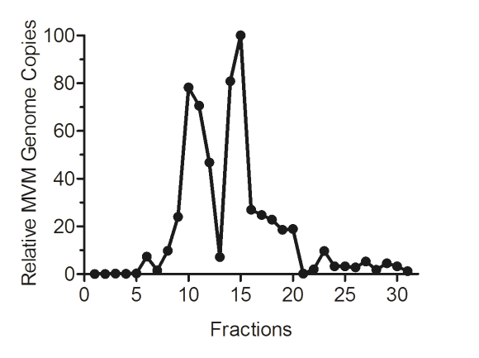
Fig. 1
A
B
C
7
8
9
10
11
12
13
14
15
16
17
18
19
20
EC
EC

Slide 2
Fig. 2
A
B
C
D

Slide 3
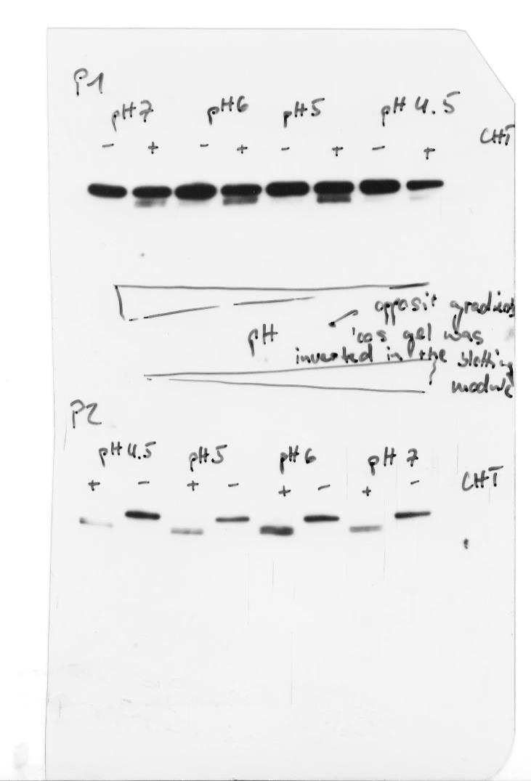
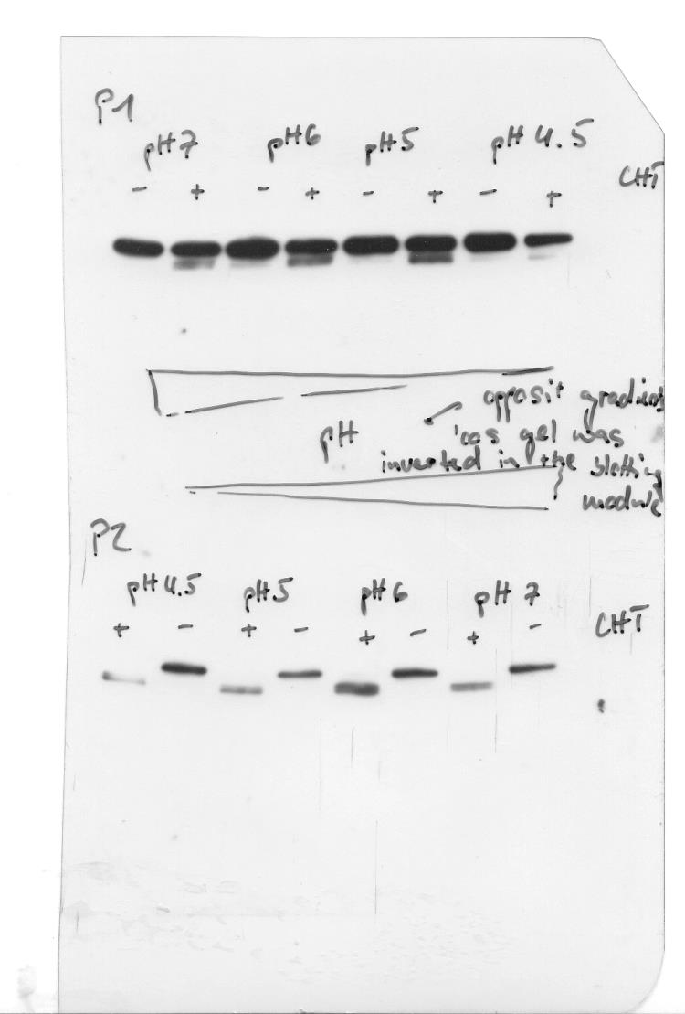
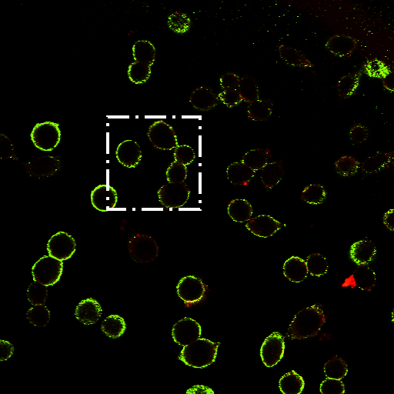
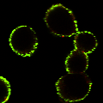
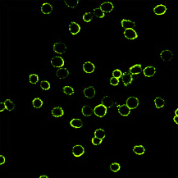
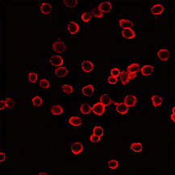
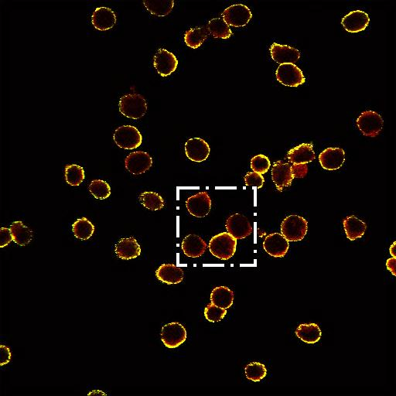
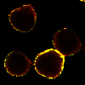
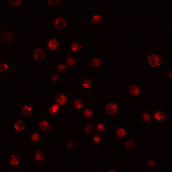
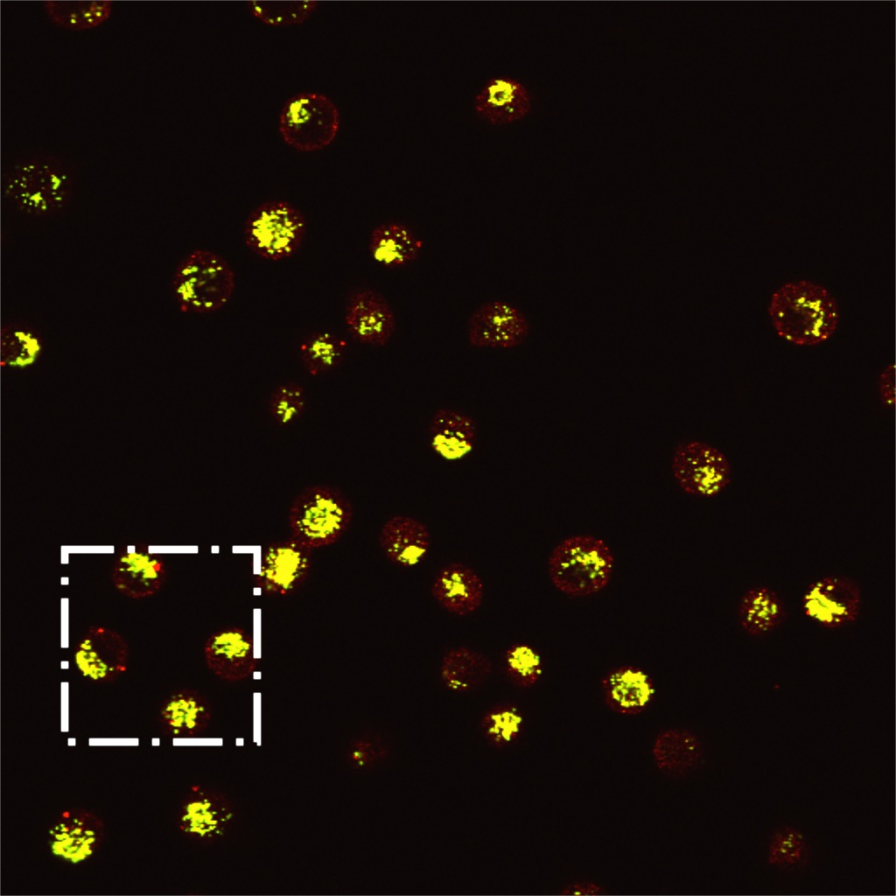
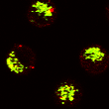
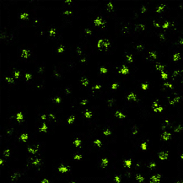
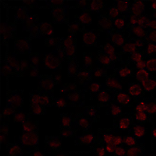
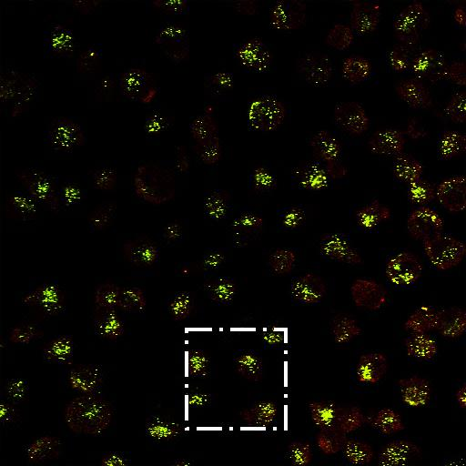
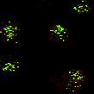
Fig. 3
A
B
C
D
E
pH 7
pH 6
pH 5
-
+
-
+
-
+
CHT
P1
VP2
VP3
P2
VP2
VP3
F
α Capsid
α N-VP2
Merge
Detailed
P1
Binding
P2
P1
4h Internalization
P2

Slide 4
Fig. 4
A
WT
C
D

Slide 5
Fig. 5
A
B
C
D

Slide 6
Fig. 6

Slide 7
Fig. 7
A
Incoming virions
B
Progeny virions
A9
A9
NB324K
5 min
10 h
10 h
6 h
14 h
14 h
6 h + BafA₁
18 h
18 h

